Slide 1


Slide 2

Enduring Persecution. Vs 1-4
This is Herod (title) Agrippa (family name) the first.
He is the grandson of Herod the Great = builder and baby butcher.
He’s the father of the Agrippa that Paul meets Ch26.
Acts 26:27-28 King Agrippa, believest thou the prophets? I know that thou believest. 28 Then Agrippa said unto Paul, Almost thou persuadest me to be a Christian.

Slide 3
Enduring Persecution. Vs 1-4
This is Herod Agrippa the first.
Vex = afflict, evil, harm, hurt.

Slide 4

John 15:18-21 If the world hate you, ye know that it hated me before it hated you. 19 If ye were of the world, the world would love his own: but because ye are not of the world, but I have chosen you out of the world, therefore the world hateth you. 20 Remember the word that I said unto you, The servant is not greater than his lord. If they have persecuted me, they will also persecute you; if they have kept my saying, they will keep yours also. 21 But all these things will they do unto you for my name's sake, because they know not him that sent me.

Slide 5
John 16:33b …In the world ye shall have tribulation: but be of good cheer; I have overcome the world.

Slide 6
Acts 5:40-42 And to him they agreed: and when they had called the apostles, and beaten them, they commanded that they should not speak in the name of Jesus, and let them go. 41 And they departed from the presence of the council, rejoicing that they were counted worthy to suffer shame for his name. 42 And daily in the temple, and in every house, they ceased not to teach and preach Jesus Christ.

Slide 7
Leviticus 23:4-8 These are the feasts of the LORD, even holy convocations, which ye shall proclaim in their seasons. 5 In the fourteenth day of the first month at even is the LORD'S passover. 6 And on the fifteenth day of the same month is the feast of unleavened bread unto the LORD: seven days ye must eat unleavened bread. 7 In the first day ye shall have an holy convocation: ye shall do no servile work therein. 8 But ye shall offer an offering made by fire unto the LORD seven days: in the seventh day is an holy convocation: ye shall do no servile work therein.

Slide 8
Herod’s goal?
To pull the church’s faith away from the resurrection of Jesus and into a submission to Judaism without Jesus under fear of his rule.

Slide 9
Enduring Persecution. Vs 1-4
This is Herod Agrippa the first.
Vex = afflict, evil, harm, hurt.
Peter’s arrest
  Heavy security. 16 soldier guards.
  He was chained to 2 of them!
  At Easter!

Slide 10
Escaping Prison! Vs 5-6
Yes Peter was in bondage, BUT the church was in prayer.
Praying how?

Slide 11
John 21:18 Verily, verily, I say unto thee, When thou wast young, thou girdedst thyself, and walkedst whither thou wouldest: but when thou shalt be old, thou shalt stretch forth thy hands, and another shall gird thee, and carry thee whither thou wouldest not.

Slide 12
Romans 8:35-39 Who shall separate us from the love of Christ? shall tribulation, or distress, or persecution, or famine, or nakedness, or peril, or sword? 36 As it is written, For thy sake we are killed all the day long; we are accounted as sheep for the slaughter. 37 Nay, in all these things we are more than conquerors through him that loved us. 38 For I am persuaded, that neither death, nor life, nor angels, nor principalities, nor powers, nor things present, nor things to come, 39 Nor height, nor depth, nor any other creature, shall be able to separate us from the love of God, which is in Christ Jesus our Lord.

Slide 13
Escaping Prison! Vs 5-6
Yes Peter was in bondage, BUT the church was in prayer.
Praying how? In faith!
The angel has to strike Peter to wake him!
  Totally at peace! Totally in faith. At rest!
  Prayer is critical. But in facing the trial? Faith is everything.
  Just take a nap.

Slide 14
Psalm 127:1-2 Except the LORD build the house, they labour in vain that build it: except the LORD keep the city, the watchman waketh but in vain. 2 It is vain for you to rise up early, to sit up late, to eat the bread of sorrows: for so he giveth his beloved sleep.

Slide 15
Psalm 3:1-6 LORD, how are they increased that trouble me! many are they that rise up against me. 2 Many there be which say of my soul, There is no help for him in God. Selah.
3 But thou, O LORD, art a shield for me; my glory, and the lifter up of mine head. 4 I cried unto the LORD with my voice, and he heard me out of his holy hill. Selah. 5 I laid me down and slept; I awaked; for the LORD sustained me. 6 I will not be afraid of ten thousands of people, that have set themselves against me round about.

Slide 16
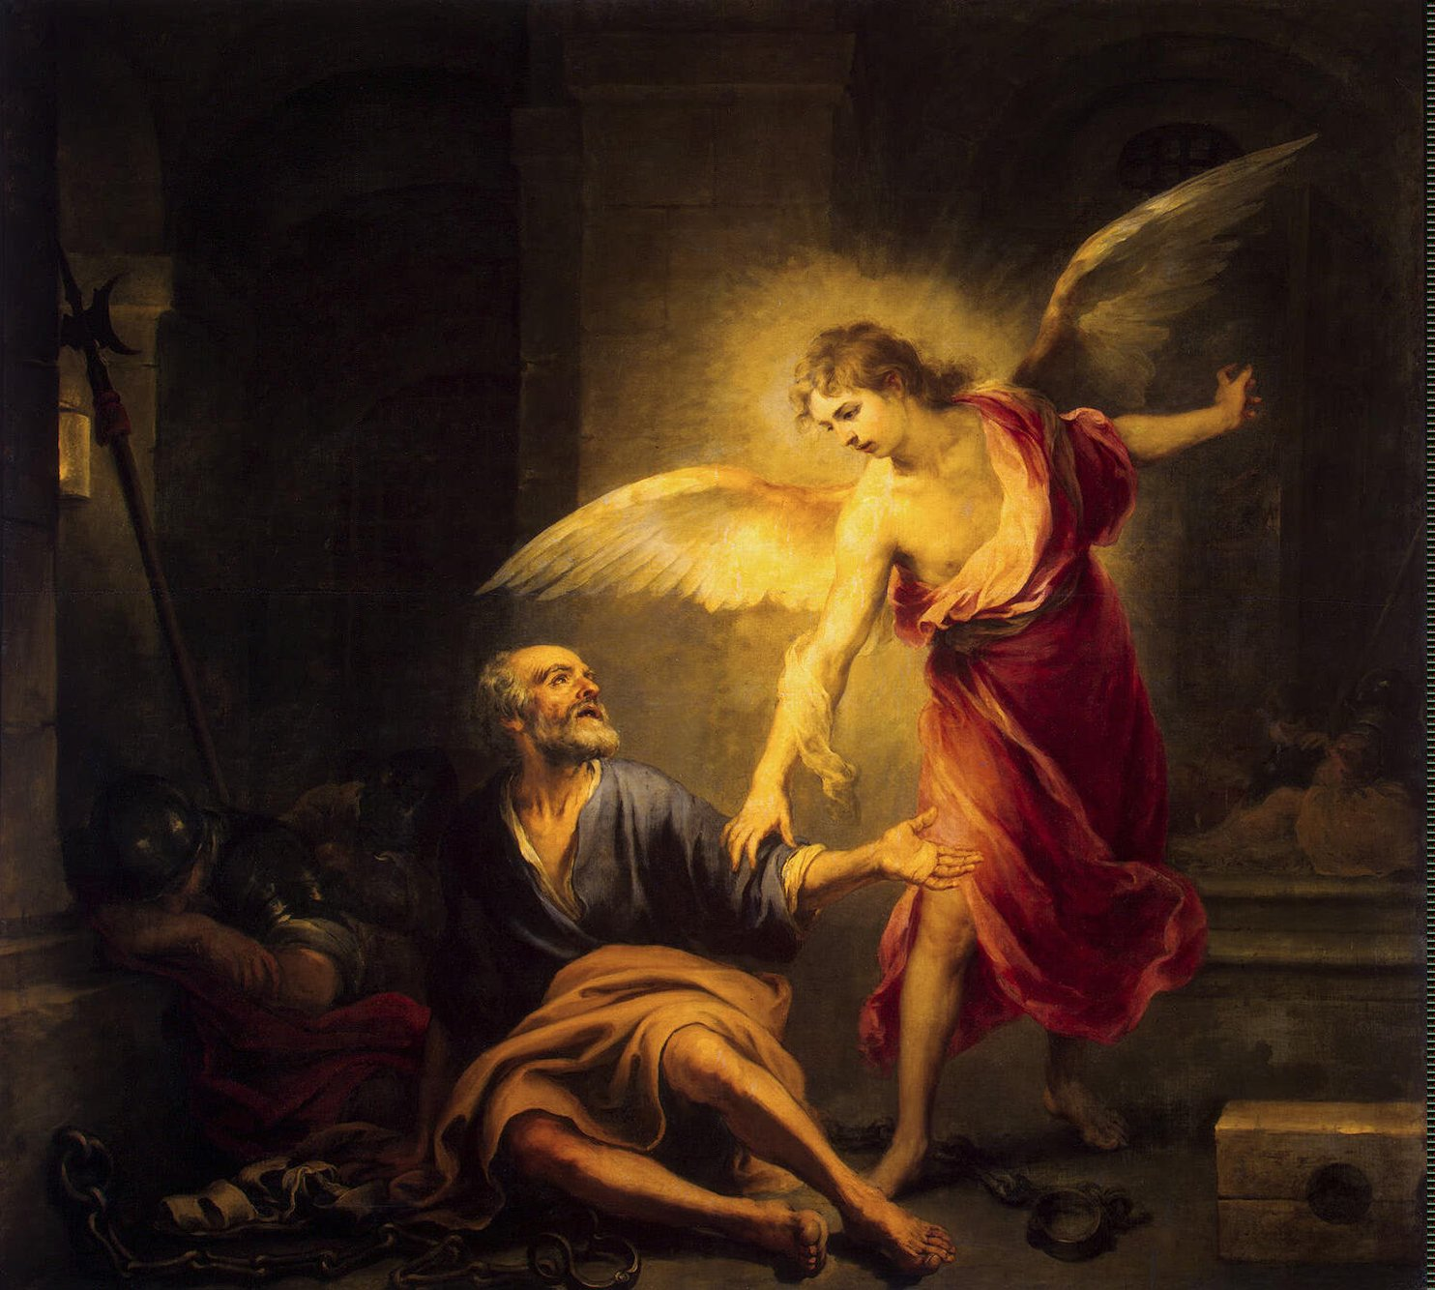
A Picture of Salvation! Vs 7-11

Slide 17
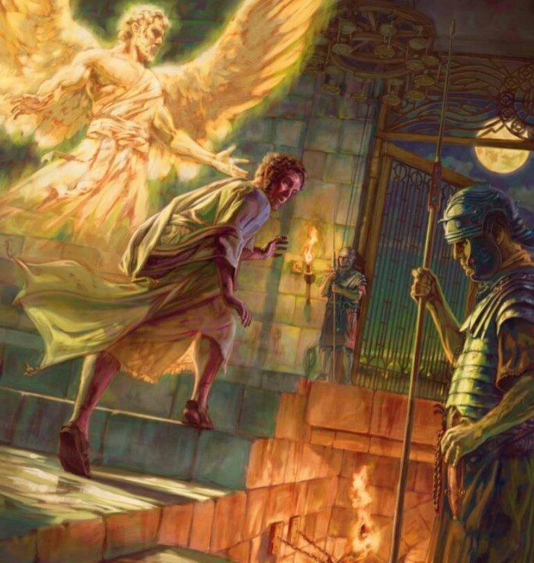
A Picture of Salvation! Vs 7-11

Slide 18
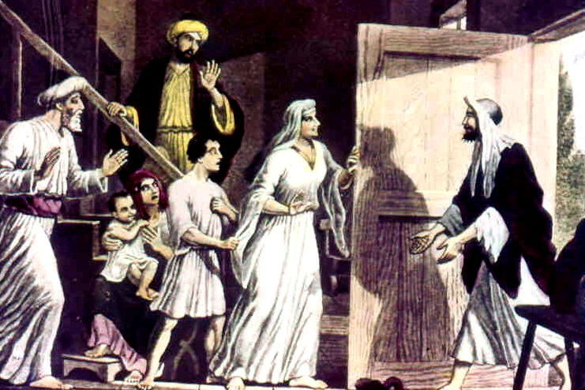
The Praise in Salvation! Vs12-19

Slide 19
Notice that in order to give God glory, (for others to see it) Peter had to be patient and persistent!
Once delivered, Peter immediately testified to the church.

Slide 20
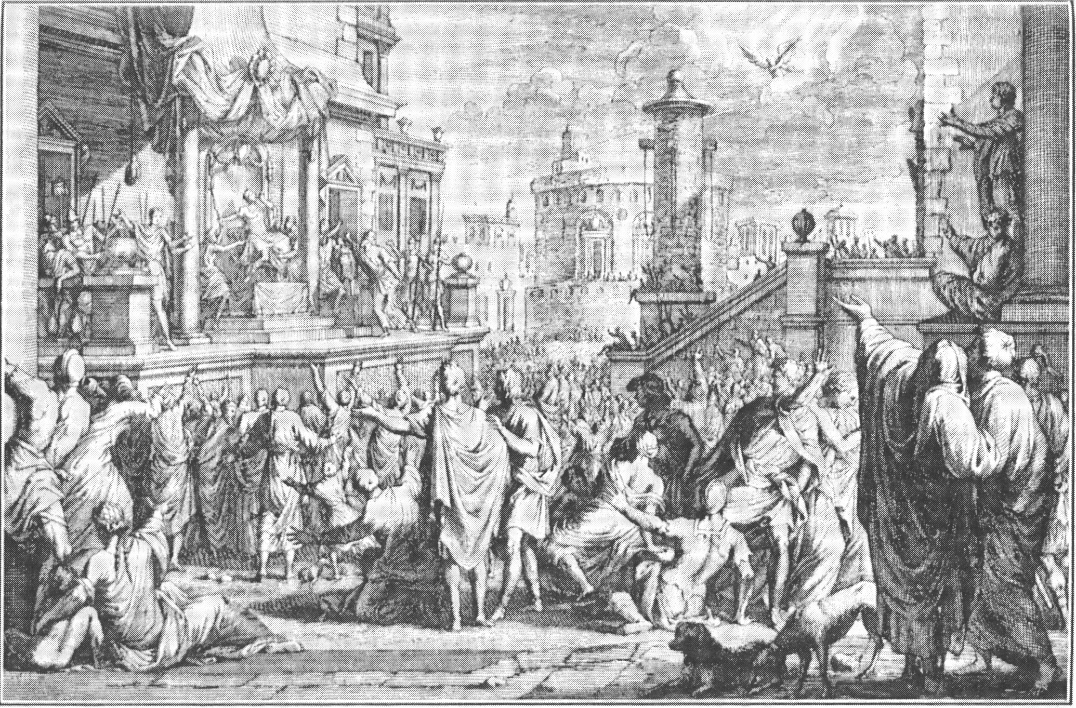

Slide 21
Matthew 28:11-15 Now when they were going, behold, some of the watch came into the city, and shewed unto the chief priests all the things that were done. 12 And when they were assembled with the elders, and had taken counsel, they gave large money unto the soldiers, 13 Saying, Say ye, His disciples came by night, and stole him away while we slept. 14 And if this come to the governor's ears, we will persuade him, and secure you. 15 So they took the money, and did as they were taught: and this saying is commonly reported among the Jews until this day.

